Slide 1
Sebastopol City
Community Assessment Report
Fauzia Waqar

Slide 2
Community Assessment Process
2021 Portrait of Sonoma
2022 County of Sonoma Point-In-Time Count Results-
Housing Needs Data Report Sebastopol, 2021
2019 Sonoma County Summary Measures of Health
2019 Sebastopol City Profile and Projections Report
City of Sebastopol Local Hazard Mitigation Plan 2021
Local government websites: The City of Sebastopol's official website
US Census Bureau: https://www.census.gov/quickfacts/sebastopolcitycalifornia
Online data tools: Websites such as city-data.com

Slide 3
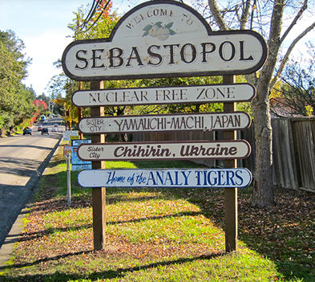
Description of the Service Area
Location: Sebastopol is located north of San Francisco, about 55 miles away.
Size: Sebastopol covers an area of about 1.9 square miles in the western part of Sonoma County.
Natural Environment: It is surrounded by hillsides, vineyards, and the Laguna de Santa Rosa River.
City Boundaries: The city's boundaries are mostly defined by its natural environment, including the Laguna de Santa Rosa River and wetland preserve.
Water Sources: The Laguna de Santa Rosa River is supplied by Santa Rosa Creek, Zimpher Creek, Calder Creek, and Witter Creek.
Access: Convenient access to the Bay Area region due to the intersection of State Route (SR-) 12 and SR 116 within the city limits.
Attractions: Sebastopol offers a vibrant food, wine, and art scene and is appealing to visitors due to its proximity to the San Francisco Bay Area

Slide 4
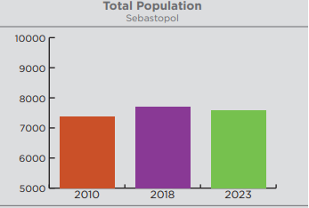
Population
Population: Sebastopol had a population of 7,448 in 2021, according to the US Census Bureau's American Community Survey.
Population Change: The population declined by -0.9% from April 2020 to July 2021.
Factors Influencing Decline: Possible factors contributing to the population decline include migration, an aging population, a low birth rate, and economic conditions.
Impact on Economy and Development: The stable population and slow growth rate in Sebastopol may impact the city's economy and development, suggesting a potential lack of job opportunities or a high cost of living.
Source: Economic Development Board Report, 2019

Slide 5
Race and Ethnicity
The demographic composition can have implications for education, healthcare, and social and economic opportunities.
For Example, the Hispanic or Latino community, which represents a significant proportion of the population, may face barriers to accessing healthcare services if language or cultural differences are not adequately addressed.
In Sonoma County, Latinos, and Native Americans had higher mortality rates due to COVID-19 in 2020, highlighting health disparities and potential systemic racism and discrimination. (A Portrait of Sonoma County 2021 Update)
Health Disparities: Deaths among Latino residents were also higher due to kidney disease and suicide, indicating underlying health inequities. (do)
Race/Ethnicity | Value
White | 78.1%
Hispanic or Latino | 14.7%
Two or more races | 7.6%
Asian | 4.4%
Other races | 1.4%
Source: US Census Bureau, 2021

Slide 6
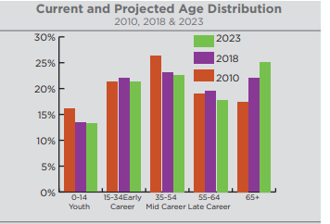
Age Distribution
Population Composition: The population of Sebastopol has a higher proportion of Late-Career and Older Adults.
Smaller Proportion of Young Adults: There is a smaller proportion of adults aged 35 and below in Sebastopol.
Declining Numbers: Forecasts in the Economic Development Board Report suggest that all age groups under 65 will decline in numbers.
Aging Population: The declining numbers indicate an aging population trend in Sebastopol.
Implications: The aging population may have implications for various aspects such as workforce dynamics, healthcare needs, and community services
Source: Economic Development Board Report, 2019.

Slide 7
Racism and Discrimination
Racial Isolation Index Values for Segregation within Sebastopol
Racial Dissimilarity Index Values for Segregation within Sebastopol
Race | 2010 | 2020
Asian/Pacific Islander | 0.018 | 0.027
Black/African American | 0.009 | 0.010
Latinx | 0.108 | 0.144
White | 0.837 | 0.747
Race | 2010 | 2020
Asian/Pacific Islander vs. White | 0.062 | 0.058
Black/African American vs. White | 0.089 | 0.211
Latinx vs. White | 0.080 | 0.025
People of Color vs. White | 0.044 | 0.023
Source: Housing Needs Data Report, Sebastopol 2021
Racial Isolation Index: The Racial Isolation Index compares neighborhood composition to the overall demographics of the jurisdiction.
Range and Interpretation: The index ranges from 0 to 1, with higher values indicating a higher level of isolation for a particular racial or ethnic group.
White Residents in Sebastopol: According to the "Housing Needs Data Report, Sebastopol 2021," White residents in Sebastopol have an isolation index value of 0.747.
Meaning of the Value: This value suggests that, on average, white residents in Sebastopol live in neighborhoods where approximately 74.7% of the residents are also white.
Source: Housing Needs Data Report, Sebastopol 2021
Economic Disparities: People of color are more likely to experience poverty and financial instability due to historical exclusion from opportunities.
Housing Insecurity: Economic disparities can leave communities of color at a higher risk for housing insecurity, displacement, or homelessness.
Highest Poverty Rates: In Sebastopol, Black or African American residents experience the highest poverty rates.
Followed by Hispanic or Latinx Residents: Following Black or African American residents, Hispanic or Latinx residents also face relatively high poverty rates in Sebastopol.

Slide 8
Sebastopol City HDI by Census Tract
 | Human Development Index | Life Expectancy at birth | Less than High School (% of adults 25+) | At least Bachelor’s Degree (% of adults 25+ | Graduate or Professional degree (% of adults 25+) | School Enrollment (%) ages 3 to 24 | Median Earnings($) | Health Index | Education Index | Income Index
Sonoma County | 6.19 | 82.2 | 10.2 | 37.8 | 14.6 | 78.4 | 40,531 | 6.77 | 5.85 | 5.96
South West Sebastopol | 6.32 | 84.0 | 1.7 | 52.5 | 19.9 | 80.5 | 31,170 | 7.50 | 7.32 | 4.14
North Sebastopol | 6.26 | 83.1 | 5.2 | 44.6 | 16.6 | 74.9 | 38,097 | 7.13 | 6.13 | 5.53
West Sebastopol/Graton | 6.16 | 84.5 | 11.1 | 41.4 | 15.5 | 73.1 | 36,736 | 7.71 | 5.50 | 5.28
Southeast Sebastopol | 5.64 | 80.03 | 7.3 | 44.7 | 21.6 | 79.6 | 31,676 | 5.96 | 6.71 | 4.25
South West Sebastopol: Has the highest level of human development
North Sebastopol: Has a slightly lower HDI value compared to South West Sebastopol.
Southeast Sebastopol: Have lower HDI values compared to other areas.
Indicates a need for more support or resources to improve health, education, and the standard of living for residents in these areas.
Source: A Portrait of Sonoma County 2021 Update
Notes:
In general, a higher value of HDI indicates a higher level of human development and well-being. The HDI ranges from 0 to 1, with higher values indicating higher development

Slide 9
Employment Rate
According to Economic Development Report, 2019, Sebastopol city has a higher annual average unemployment rate that is 4.12% as compared to the rest of Sonoma County cities.
One potential cause of the higher unemployment rate in Sebastopol city could be related to the types of industries and businesses in Sebastopol. Another factor can be a mismatch between the skills of the local workforce and the needs of the local employers.
Sebastopol's unemployment rate has been decreasing over the last two years, declining by 0.8% since 2017, in line with the trend in Sonoma County

Slide 10
Housing and Homeless
Sonoma County Homeless, 2022 report reflects that Sebastopol City has made significant progress in addressing housing needs
Homelessness in 2020: In 2020, 129 people were reportedly experiencing homelessness in Sebastopol.
Increase from 2019: This marked a 20 percent increase in homelessness compared to the previous year (2019).
Ad Hoc Committee: City council members established an ad hoc committee in 2021 to address the declared homelessness emergency in Sebastopol.
 | Unsheltered |  |  | Sheltered |  |  | Total
 | 2019 | 2020 | 2022 | 2019 | 2020 | 2022 | 2019 | 2020 | 2022
West County | 271 | 290 | 62 | 41 | 37 | 65 | 312 | 327 | 127
Sebastopol City | 101 | 129 | 40 | 0 | 0 | 38 | 101 | 129 | 78
Incorporated | 170 | 191 | 22 | 41 | 37 | 27 | 211 | 228 | 49

Slide 11
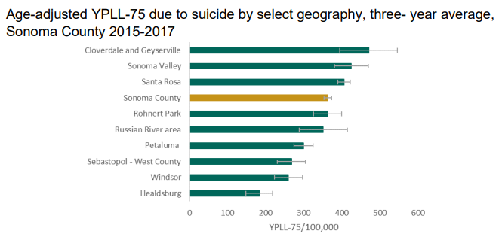
Mental Health
According to the “2019 Sonoma County Summary, Measures of Health”, suicide is the fifth leading cause of death in the Sebastopol area (200 deaths).
YPLL-75 Value: A YPLL-75 value of 200-300 per 100,000 in Sebastopol indicates a significant burden of premature mortality due to suicide.
Suicide-related YPLL-75: The specific YPLL-75 value related to suicide suggests that individuals dying by suicide are doing so at a younger age.
Impact on Prime Years of Life: This indicates that mental health issues are affecting people in their prime years of life, resulting in premature deaths by suicide.
Notes:
YPLL stands for Years of Potential Life Lost. It is a measure that quantifies the impact of premature deaths on a population. YPLL calculates the number of years that individuals would have lived if they had not died prematurely. It is typically calculated by subtracting the age at death from a specified age, often 75 years. YPLL helps to assess the burden of premature mortality and can be used to compare the impact of different causes of death or to identify disparities in health outcomes among different populations.

Slide 12
Disadvantaged Communities (DACs)
-
DAC: According to the "City of Sebastopol Local Hazard Mitigation Plan, 2021," there is a single block group on the northwest side of Sebastopol identified as a DAC (Disadvantaged Area Community).
Location: The DAC block group is located in downtown Sebastopol.
Population: It is home to approximately 977 residents living in 416 households.
Median Household Income: The median household income in this DAC block group is $53,750.

Slide 13
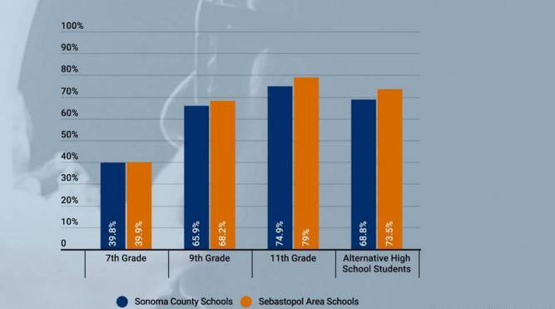
Tobacco Use
Youth Perception of Access to E-Cigarettes as Easy/Very Easy
Teen Tobacco and Nicotine Use: The usage rate of tobacco and nicotine among teens in Sebastopol is higher than the average rate in Sonoma County.
Exceeding State Average: The usage rate of tobacco and nicotine among teens in Sebastopol is more than double the state average
Many youths may perceive e-cigarettes to be a safer alternative to traditional cigarettes, which could be driving the trend.
Flavored e-cigarettes: E-cigarettes come in a wide range of flavors, which may be more appealing to youths than traditional tobacco flavors.
Source: California Health Kids Survey, 2018-2019, (as mentioned by City of Sebastopol City Council Agenda Item 19

Slide 14
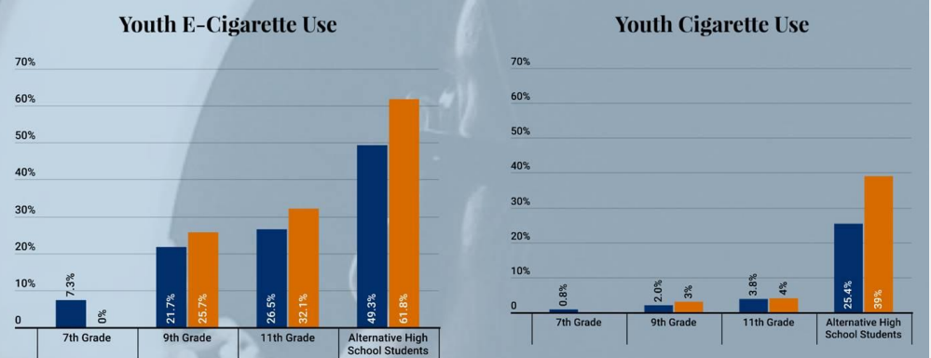
Tobacco Use
E-cig use is trending over cigarette use
According to the Sonoma County School Vaping survey conducted in 2018-2019, local middle and high schools in Sebastopol reported confiscating an average of 758 electronic devices per month.
Widespread Use of E-cigarettes: The high number of confiscated devices suggests the widespread use of e-cigarettes and vaping products among teens in the community.
Alarming Rate: The high rate of electronic device confiscations is alarming, indicating a significant issue with teen tobacco and nicotine use in Sebastopol.
Need for Interventions: The findings highlight the urgent need for targeted interventions to address and reduce teen tobacco and nicotine use in the Sebastopol community.
Source: California Health Kids Survey, 2018-2019, (as mentioned by City of Sebastopol City Council Agenda Item 19

Slide 15
Opportunities
Living Wage to $17.25 per hour, a 2.74 percent increase. The Living Wage is adjusted annually and currently stands at $19.65 per hour in Sebastopol city, as it is part of Sonoma County.
Plan Bay Area 2050 Final Blueprint
Sonoma Works
Voices Sonoma
Social Advocates for Youth, Sonoma County (SAY
Big Brothers Big Sisters of Bay Area
The North Bay Organizing Project (NBOP)
Sonoma County PACEs Connection
Sonoma County Behavioral Health Division
The Sonoma County Prevention Partnership
Buckelew Programs

